Slide 1
Jahan University Vice Chancellor Office Computer Science Faculty
Database Department
Object Oriented Programming
Semester: 3th
Lecture: 01
Prepare by: Saif Ur Rahman Quraishi Year:2024

Slide 2
Chapter No 1
Object-Oriented Programming using JAVA

Slide 3

Course Objectives
Course will provide pure concept of object oriented programing to students through Java programming
After completing this course, students would be gained with some of the underlying concepts of object orientation and would be able to develop small and intermediate object-oriented application
Students would be able to learn advance java programming language

Slide 4
Grading Policies

Slide 5
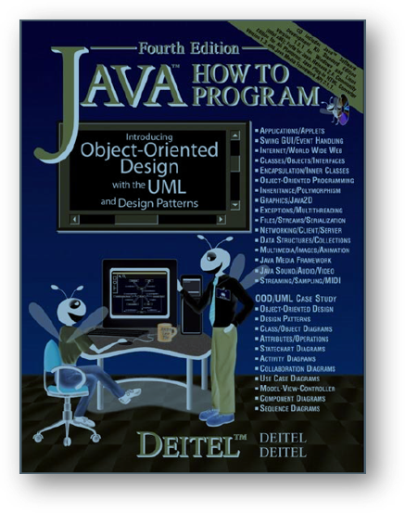
Text Books to Recommended!!!!!

Slide 6
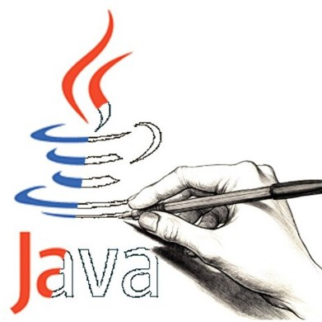
Lecture Agenda
What is Java?
History and Features of Java
What is Platform Independent?
Importance of Java
C/C++ vs. Java

Slide 7
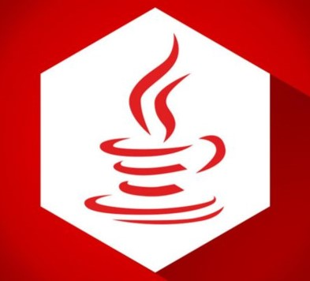
What is JAVA?
Java is a widely used programming languages that was originally developed by sun Microsystem.
Unofficial abbreviation of Java is Just Another Virtual Analyzer (JAVA)
Java is an object oriented languages
Java has a large standard library that provides a wide range of pre built classes and methods for common tasks such as I/O operation, Networking, databases access.
Allowing developer to write a programs that ca preform multiple task at same time
Write Once Run Anywhere (WORA) – Platform independent (Slogan)

Slide 8

Who Can Study JAVA?
Any student with an IT/Non IT background can study java

Slide 9
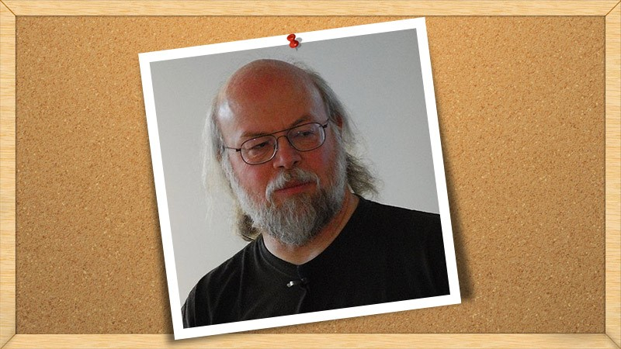
Who is the Father of java?

Slide 10
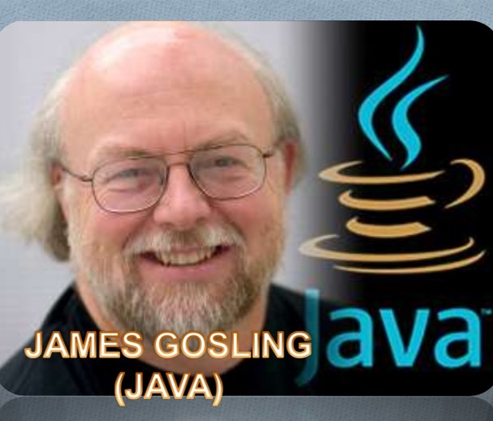
James Gosling
James Gosling is a famous Canadian software developer who is the recognized as the original developer of the java programming language.

Slide 11
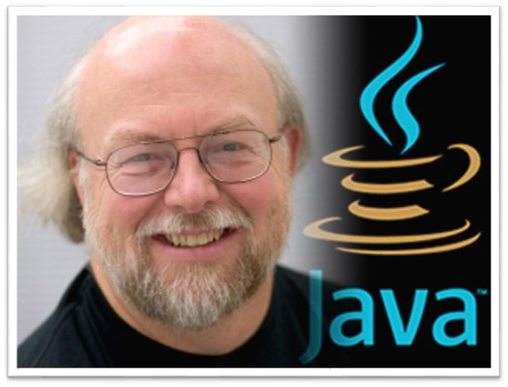
Father of Java
Hopelessly focused one platform
Name: James Gosling
Born: May 19, 1955
Residence: United States
University: Camegie Mellon University
Occupation: Computer Scientist
Employer: Sun Microsystems

Slide 12
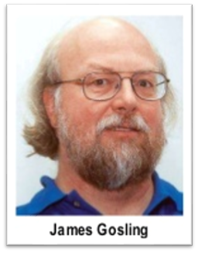
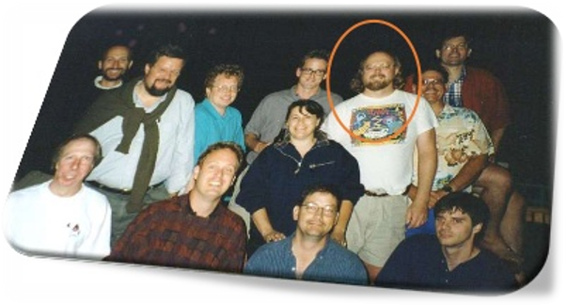
A Brief History of Java
James Gosling, Mike Sheridan, and Patrick Naughton initiated the Java language project in June 1991
The small team of Sun engineers called Green Team

Slide 13
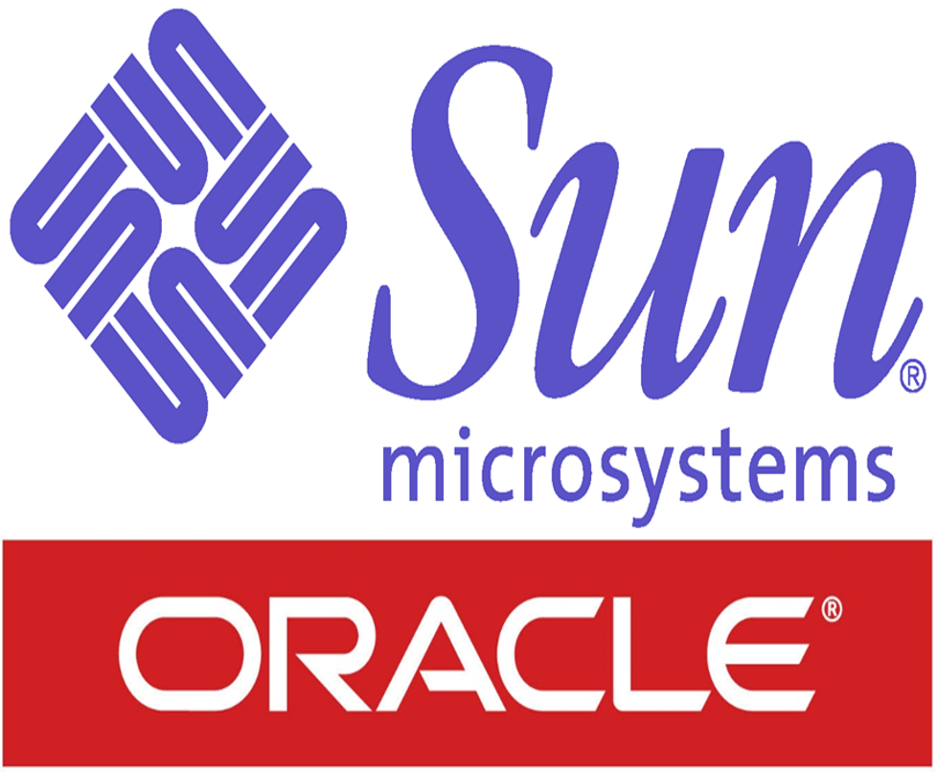
A Brief History of Java (Con…)
There are given the major points that describes the history of java.
Who invented java?
James Gosling
Where?
SUN lab also known as sun microsystem
When?
Around 1991, published in 1995
When oracle acquired Sun Microsystem?
Oracle Acquired Sun in 2009 - 2010

Slide 14
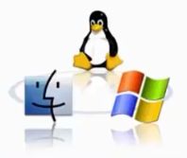
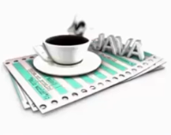

Java Features
Important Features of java are:
Simple
Secure
Platform independent
Java was designed to be easy for professional programmer to learn and use effectively.
No need to worry about memory management because there is Automatic Garbage Collection in java.
Java provides a secure means of creating internet application, Java provides secure way to access web application.
Java can execute in any environment, java programs can be run on any platform like windows, Mac, Linux.

Slide 15
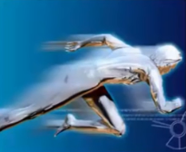
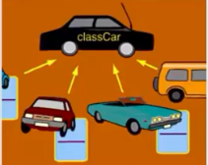

Java Features (Con…)
Important Features of java are:
High Performance
Object-Oriented
Multithreaded
Java provides integrated support for multithreaded programming
Java byte codes are highly optimized JVM can executed them much faster
Java provides most of object oriented features, Java is pure OOP Language

Slide 16


Java Features (Con…)
Java Features (Con…)
Dynamic
Distributed
During execution of a program, java can dynamically load class libraries that it require
Multiple programmers at different remote location can collaborate and work together

Slide 17
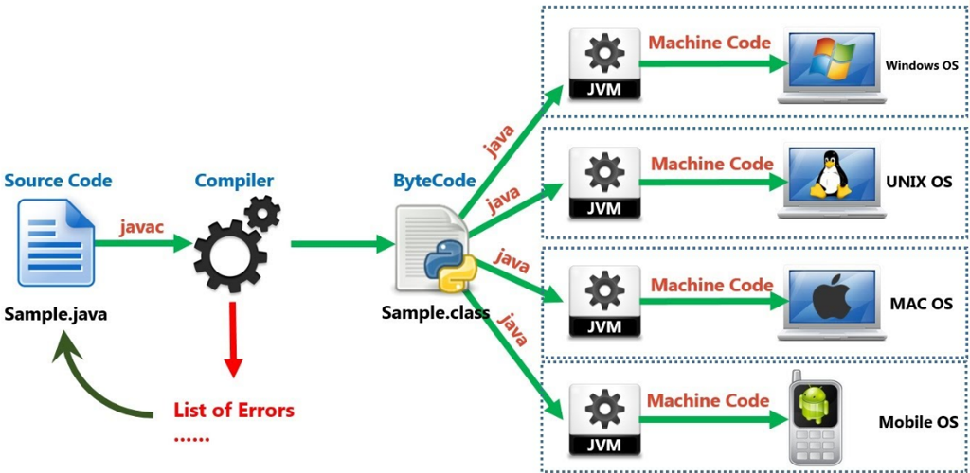
What is a Platform Independent?

Slide 18
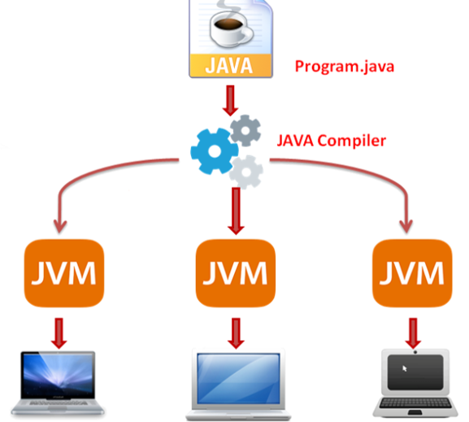
Platform Independent
Java is a platform independent language
Platform Independent is the best feature of java
What do you means by platform independent?
Platform independent means writing codes in one operating system (for example windows 10) and executing that code on another platform (for example Linux)

Slide 19

Platform Independent (Con…)
Java bytecode can be run on multiple platforms e.g. Windows, Linux, Mac/OS etc.
WORA - Write Once and Run Anywhere

Slide 20
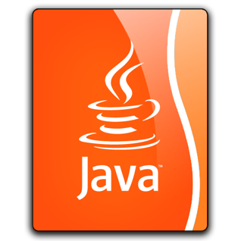
What is Platform?
A platform is hardware or software environment in which a program runs
There are two types of platforms
Software-based Platform
Hardware-based Platform
Java provides software-based platform

Slide 21
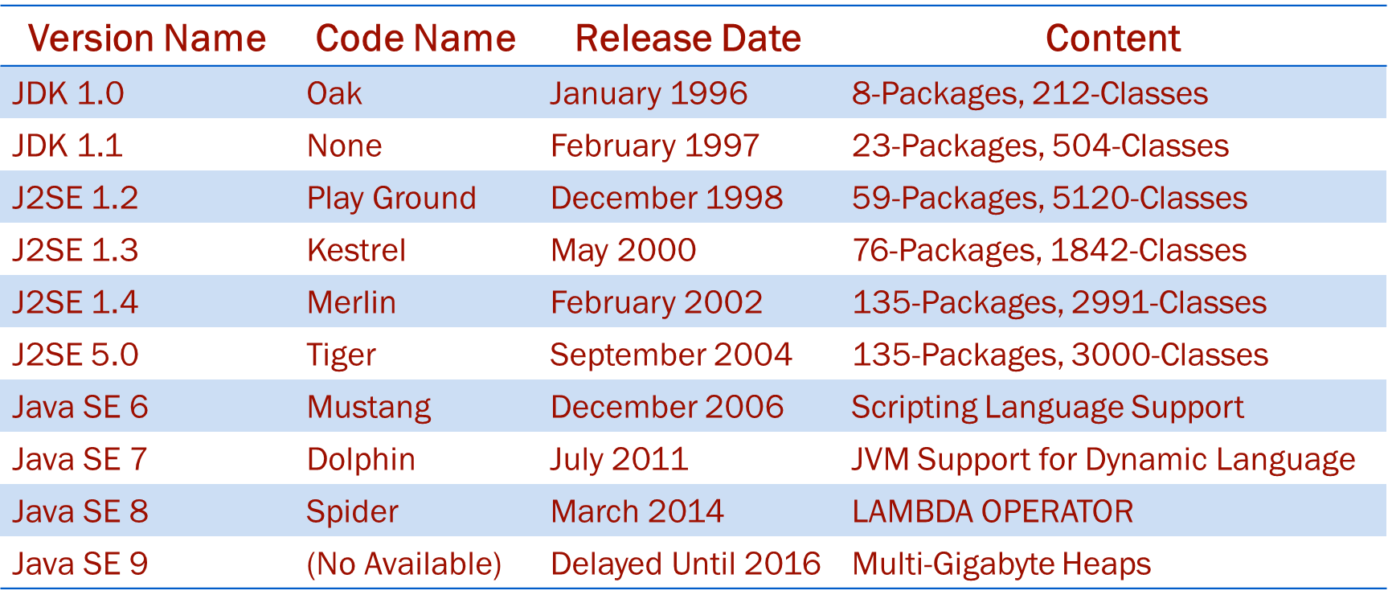
Versions of Java

Slide 22

Why JAVA is so Important Today?
Two reason:
Trouble with C/C++ language is that they are not portable and are not platform independent languages.
Emergence of world wide web, which demanded portable program.
Portability and security necessitated with the invention of java

Slide 23
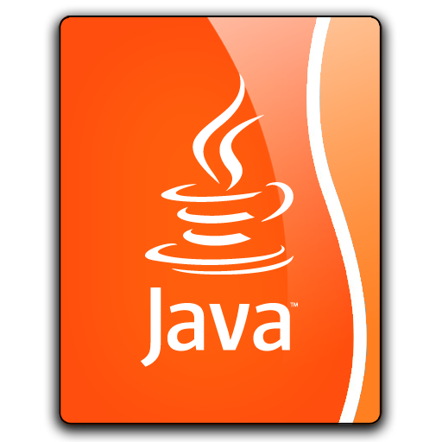
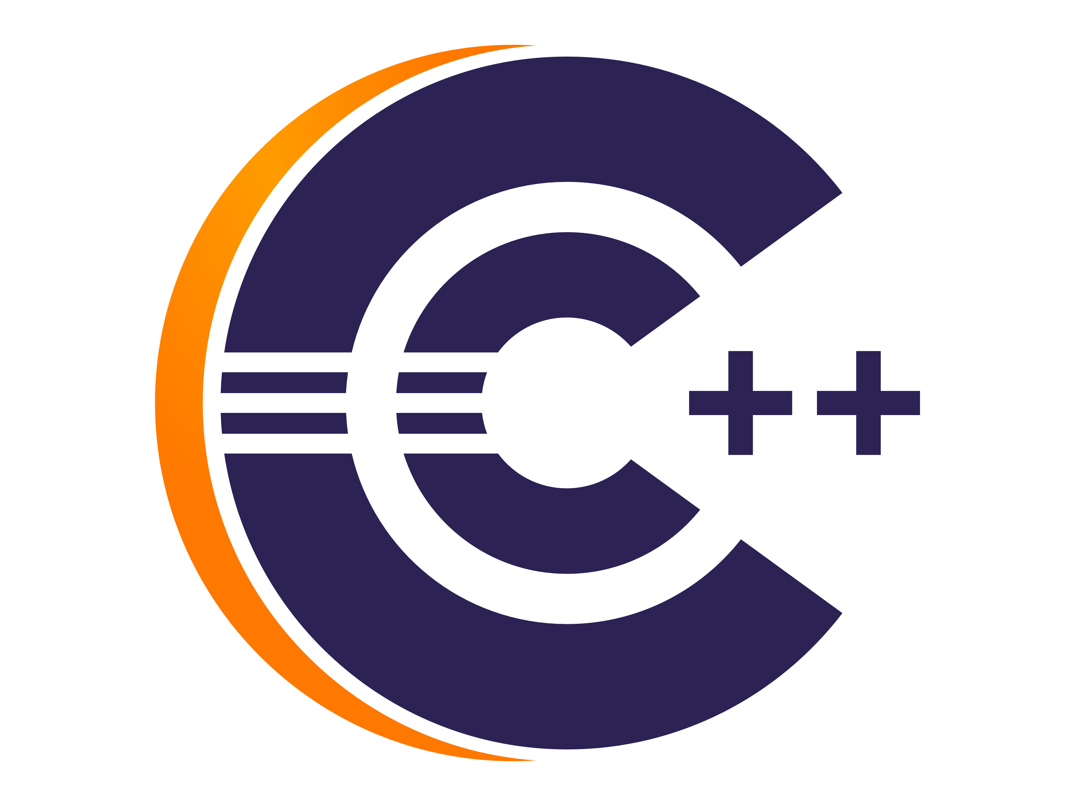
C++ vs. JAVA
VS.

Slide 24
C/C++ vs. JAVA (Con…)
C++ Programming Language | JAVA Programming Languages
Platform-dependent | Platform-independent
Uses compiler only | Uses compiler and interpreter both
Mainly used for system programming | Mainly used for application programming like window, web-based, enterprise, mobile application…
Supports both call by value and call by reference | Supports call by value only. There is no call by reference in java.

Slide 25
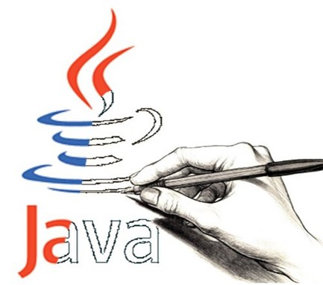
Lecture Summary
What is Java?
History and Features of Java
What is Platform Independent?
Importance of Java
C++ vs. Java

Slide 26
Thank You! For Your Patience
Your Frequently Asked Questions, Answered!

